Slide 1
Speech Based Tennis Ball Collector
Subhabrata Mukherjee 10305061
Dhaval Manvar 10305021
Janardhan Singh 10305067 (Team Leader)

Slide 2
Software Requirements
Scilab and SIVP : Image processing
Java: Speech API
Esterel: Controlling the firebird bot

Slide 3
Hardware Requirements
Laptop
Bot
ZigBee Module
Camera
Arm
Microphone

Slide 4
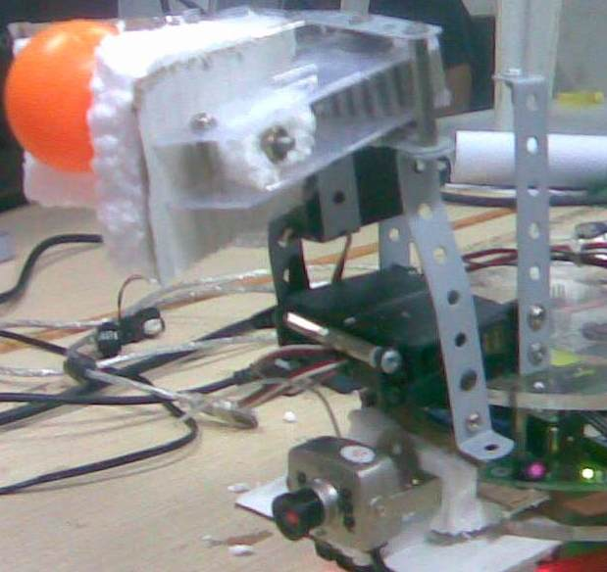
Firebird Bot

Slide 5
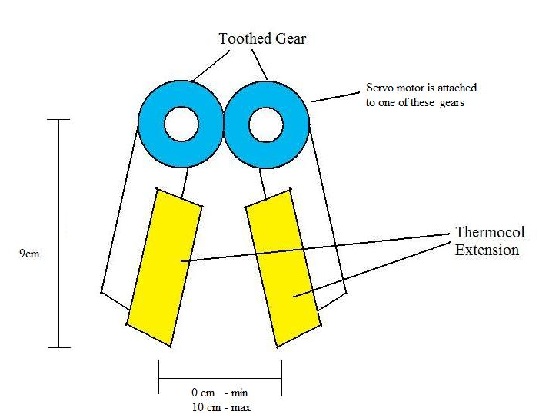
Arm Specification

Slide 6
Concepts from Course
Statechart
Modelling all possible states of the bot in motion with and without the ball
Communication with Command&Control Center through ZigBee
Esterel
Converting statechart to Esterel code

Slide 7
Speech processing in JAVA
Implemented using JAVA Speech API
Developed using the Eclipse IDE.
This module writes the color, given via speech command, in a file.
The Scilab program can read the color from this file.

Slide 8
Object detection and communication with firebird implemented in Scilab
Read from the file color.txt which color of ball to pick Basket color by default is green Call: main(color_read_from_file); // call main function
function main(objc) set parameters for frame dimension open the serial communication interface with port_no=6 open the camera send 2 dummy signals to firebird to initiate it before picking ball traceobject(objc,'1','2','3','ball'); //trace ball send 2 dummy signals to firebird to initiate it before dropping ball refresh the frames and re-initiate camera traceobject('green','4','5','6','box'); //trace basket closeserial endfunction

Slide 9
Object detection and communication with firebird implemented in Scilab
/* use camshift function in scilab to trace the object in each frame Parameters: color=color of object to find; notfound=signal to be sent till object is not found; found=signal to be sent when object is found; objct=ball or basket additional parameter : action="pick" or "drop" the object when it is reached */ function traceobject(colour,notfound,found,action,objct) rectret=findobject(colour,notfound,found,objct) //call rectrec to detect the object while there is a frame captured by the camera use camshift funtion in scilab to trace the object position in the frame wait till the object comes in the centre of the frame i.e. the distance between frame centre and object centre is less than some threshold value threshold is to be set keeping in mind that the bot is in motion if the object is at centre of frame send signal to firebird keep on sending signal till it is ack-ed keep on reading the buffer for another signal from firebird indicating that the object has been reached and action taken (ball picked or dropped) return on receiving this signal else keep on sending signal to firebird asking it to rotate slowly endfunction

Slide 10
Object detection and communication with firebird implemented in Scilab
/* function to detect object and return the co-ordinates of the object, in the 1st frame it is detected, in the vector rectrec Parameters: color=color of object to find; notfound=signal to be sent till object is not found; found=signal to be sent when object is found; objct=ball or basket */ function rectret=findobject(color,notfound,found,objct) set threshold for color intensity of the object //set manually set the window range in the frame in which to search the object, typically the mid 200 pixels in the frame while there is a frame captured by the camera subtract the color component from the image convert the image to binary perform seedfill algorithm in the specified window, to detect the biggest object cluster with threshold > 1000 pixels, at interval of 10 pixels if object found return else keep on sending signal to firebird asking it to rotate slowly endfunction

Slide 11
Controlling Firebird robot using Esterel
Signal | Source - Destination | Function
1 | Laptop – Firebird | Keep rotating
2 | Laptop – Firebird | Stop rotating, ball is in centre of input image
3 | Firebird – Laptop | Ball pick-up complete
4 | Laptop – Firebird | Keep rotating
5 | Laptop – Firebird | Stop rotating, basket is in centre of input image
6 | Firebird – Laptop | Ball dropping in the basket complete

Slide 12
Signal for Controlling Firebird Using Esterel
5 additional signals were defined :
PICK
Robot moves forward till the IR sensor detects the proximity of the ball.
The gripper opens, arm goes down and the gripper closes.
The ball is caught within the thermocol gripper and the arm moves back up.
DROP
Robot moves forward till the IR sensor detects the proximity of the basket.
The arm goes down at 45 degrees. The gripper opens to drop the ball in the basket.
The arm goes back up.

Slide 13
Signal for Controlling Firebird Using Esterel
ROTATE (SPEED,ANGLE)
The soft right rotation takes place at desired speed and angle.
RECEIVE [ZIGBEE SIGNAL]
Reads the byte input from the ZigBee serial port.
SEND [ZIGBEE SIGNAL]
Writes a byte output to the ZigBee serial port.
These signals are generic and can be used for other applications using Esterel for programming the firebird robot.

Slide 14
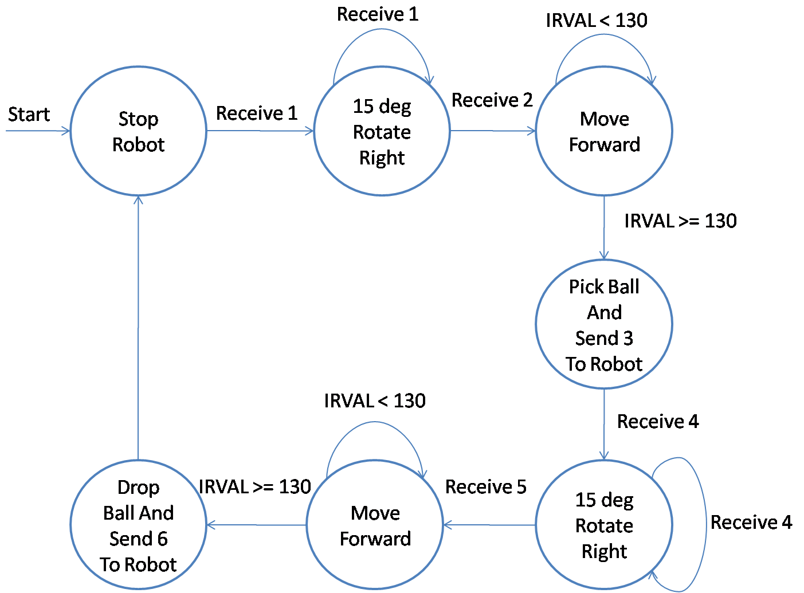
State Diagram for Esterel Control

Slide 15
Risks
Software
Accuracy of Voice Processing
Mitigation : Training
Accuracy for Image Processing and Color identification
Color the balls distinctly
Time taken for Image Processing and number of images that can be processed per second
Optimization for Image Processing to minimize delay

Slide 16
Risks contd…
Hardware
Proper functioning of the arms
Time taken by Camera to capture image
Time taken for communication through ZigBee
Tune the parameters like speed of motion, images captured per instant from real implementation
Skills
Speech to Text Conversion using Scilab/Java
Image Processing in Scilab
Bot control and communication using Esterel

Slide 17
Test Cases
Identification of Voice Command
Red, Green and Blue
Identification of Objects with given Color
Identifying the red ball in presence of the blue ball and vice versa.
Identification of Basket
Green color was designated to the basket.
Retrieval of Objects
This includes searching for the object, moving towards it, stopping due to IR sensor and grasping the ball by its robotic arm.
Placement of Objects in a Basket
This includes bringing the object towards the basket, stopping due to IR sensor and dropping the ball within the basket.

Slide 18
Observations from Testing
Test | Observation | Reason
Identification of voice commands | By keeping only three classes(red, green and blue), this task worked well | -
Identification of colored object | The threshold of color intensity needed to be tuned for red, blue and green. Sometimes some far spurious objects got detected | We detect object by cluster of pixels of the specified color of size greater than thousand pixels. Since, shape is not detected, some far objects got detected. Hence, the area needs to be clear.
Identification of basket | Same as above | Same as above
Retrieval of object | By ensuring that there is no pull from the wires attached to the robot , while it moves forward for picking the ball, this part worked well. | -
Dropping of object | By restricting the green color in the central part of the front face of basket, this part also worked well. | If the whole front face was kept green, then sometimes the robot identifies the edge of the basket and drops the ball outside or on the edge.

Slide 19
General discussion
The SIVP toolbox is maturing
Absence of some functions that are present in MATLAB viz. “bwlabel”,
Implemented our own algorithm for object identification.
Optimized the algorithm for object identification by sampling sections of image instead of entire image
Delay is minimized to synchronize the image processing and esterel automation as well as communication via zigbee
Once the object is detected, the camshift function takes over
Developed protocol for Esterel communication with Scilab
Protocol makes sure transmitted signal is received by sending repeated signals till ack-ed

Slide 20
General discussion Contd…
In the image processing part, tuning the intensity threshold of different colors for differentiating among them required significant effort.
Shape identification has not been done and can be a useful extension of this work.
Esterel api for firebird lacked some signals
Signals were added which are re-usable for further projects on firebird using Esterel.

Slide 21
Future Work
Including shape identification along with color identification.
Involve some Natural Language Processing to give more generic commands rather than just color.
Re-implementing and comparing using opencv instead of Scilab.

Slide 22
Conclusions
We extended the existing tennis ball collector by introducing a speech api
We made the project platform independent and open-source by using open source tools like scilab, java, esterel
We also developed a protocol for efficient communication between software and hardware i.e. between scilab and esterel for smooth functioning of the system

Slide 23
Thank you

